Slide 1

FreeCell Solitaire Search Problem
João Soares up202105364
João Vieira up202107689
Martim Lousado up202104630

Slide 2
TABLE OF CONTENTS
01
02
03
04
05
06
The Game
Uninformed Search
Informed Search
Single Player
LLMs
Results

Slide 3
01
The Game

Slide 4
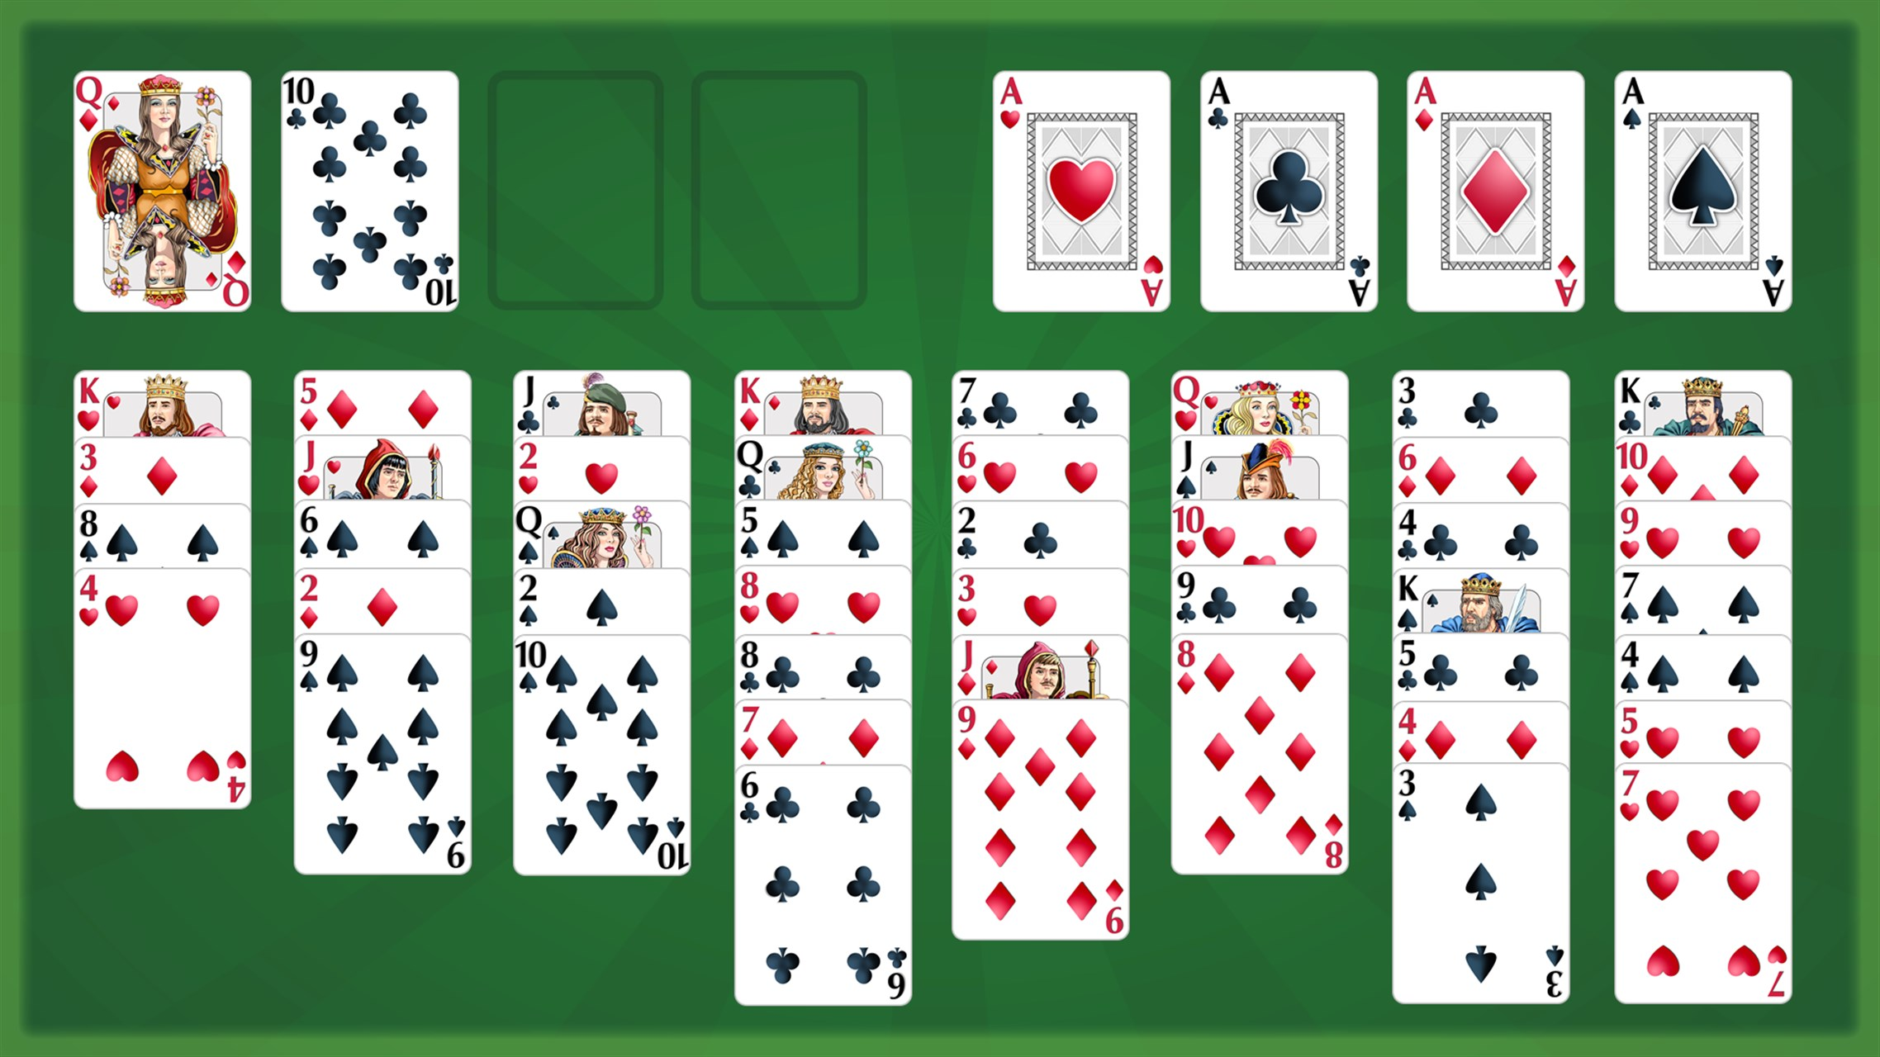
FreeCell Card Solitaire
Rules
8 face up cascades
4 free cells for 1 card
Cards can be moved to other cascades if they are 1 rank lower and of an alternate color
The objective is to fully fill the foundations
Out of 8.6 billion deals, 102075 were impossible to solve (99.999% of possible deals are solvable).
There are 1.75×10^64 distinct games.
Branching factor can vary between 8 to 10 and normal solutions have a depth of 20 to 50 moves
Notes:
Falar no branching factor possível e o que é

Slide 5
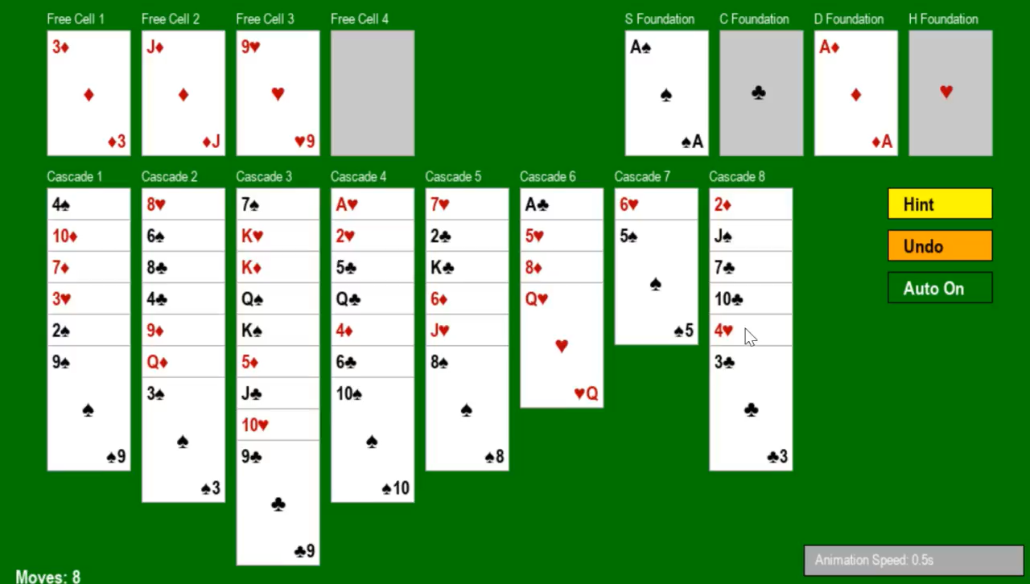
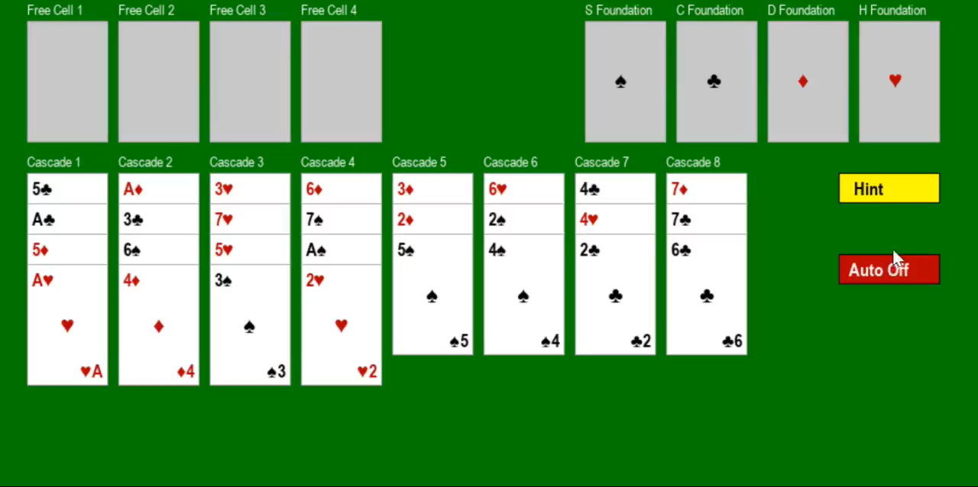
Extra Rules / Functionalities
Supermoves
With enough free spaces, multiple cards can be moved with only 1 move.
Automatic moves
Cards are automatically moved to foundation when this move would harm the solution
Notes:
Falar no branching factor possível e o que é

Slide 6
Problem Formulation
STATES:
8 cascades (columns) of cards.
4 free cells that can each hold one card
4 foundation piles (one per suit)
OPERATORS:
Cascade to foundation (8)
Free cell to foundation (4)
Cascade to free cell (8)
Cascadeto another cascade (8 x 7)
Free cell to cascade (4 x 8)
INITIAL STATE:
Complete deck of 52 playing cards (Cards distributed across 8 cascades)
Empty free cells
Empty foundation piles
SOLUTION TEST:
No cards in cascades and free cells
SOLUTION COST:
Number of card moves from initial state to goal state. Each move has a uniform cost of 1.
Notes:
States, Initial State, Operators, Solution Test, Solution Cost

Slide 7
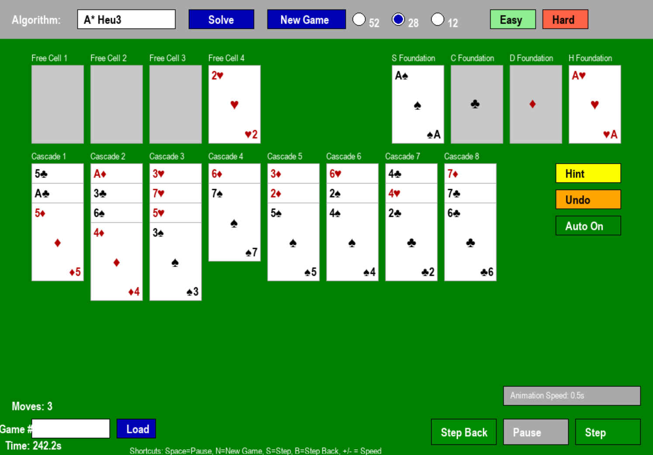
The Interface
Solving the Algorithm
Nº of Cards
Chosing Algorithm
Difficulty Settings
Single Player Buttons
AI Solving Functionalities
Choose Game Number
Notes:
Our game can be used in two ways: using the solver or you can play it yourself and ask the computer for hints
In our game you can use play Freecell in decks of 52, 28 or 12 cards, depending on your skill level or depending on the algorithm that your are using to solve or ask for hints
Besides that you can also choose a few 52 card games based on their difficulty (easy or hard). These games are stored in text files
When using the solver you can:
Select which algorithm you would like to use by clicking in the box that shows the algorithms
Control the speed by using "+" or "-" while the mouse is over the speed box
Pause the solver
Use the "Step" functionality which allows you to control when a move is made
Use the "Step Back" if you want to recall which moves were made

Slide 8
02
Uninformed Search

Slide 9
Uninformed Search Algorithms
Type of Player
Perfectionist
Bold
Balanced
BFS
Breadth First Search
DFS
Depth First Search
IDS
Iterative Deepening Search
Has the best results out of the three.
Explores all possible moves level by level
Advantage: Guarantees the shortest solution in moves
Challenge: Uses a lot of memory, storing every card position (up to 200,000 states in your limit)
Dives deep into one move sequence
Advantage: Low memory use
Challenge: Can get stuck in long, fruitless paths (depth limit of 150)
Advantage: Uses less memory
Challenge: Takes more time to find a solution

Slide 10

Uninformed Search Algorithms
200 000 Max States
The algorithms were not able to find a solution with more than 12 cards and Breadth First Search did not achieve a solution for 12 cards either
The solutions were far from optimal
Uniformed Search is not feasible for freecell solitaire (unless with higher processing capabilities)
Notes:
Automoves had good impact

Slide 11
“Empty to Empty” Optimization (E2E)
200 000 Max States
When enabled, eliminates unnecessary moves between empty cascades:
Disables unnecessary moves between empty cascades
Significantly improves performance of uninformed search algorithms (DFS and IDS)
For game2.txt, it found an optimal solution in 47 moves instead of 92, and for DFS, it found a solution in 35 moves instead of 78 moves.

Slide 12
03
Informed Search

Slide 13
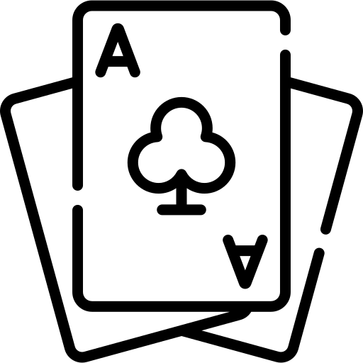


Heuristics
Missing Cards in Foundations
Measures how far the game is from completion by counting the number of cards still missing in the foundations
Minimum Moves to Foundation
Estimates the minimum number of moves required to place all cards in the foundations, considering gaps in sequences.
Context-Aware Move Estimation
Refines Heuristic 2 by considering card positioning, blockers, and required sequences to estimate a more realistic number of moves.
Notes:
Missing Cards in Foundations
Measures how far the game is from completion by counting the number of cards still missing in the foundations.
Minimum Moves to Foundation
Estimates the minimum number of moves required to place all cards in the foundations, considering gaps in sequences.
Context-Aware Move Estimation
Refines Heuristic 2 by considering card positioning, blockers, and required sequences to estimate a more realistic number of moves.

Slide 14
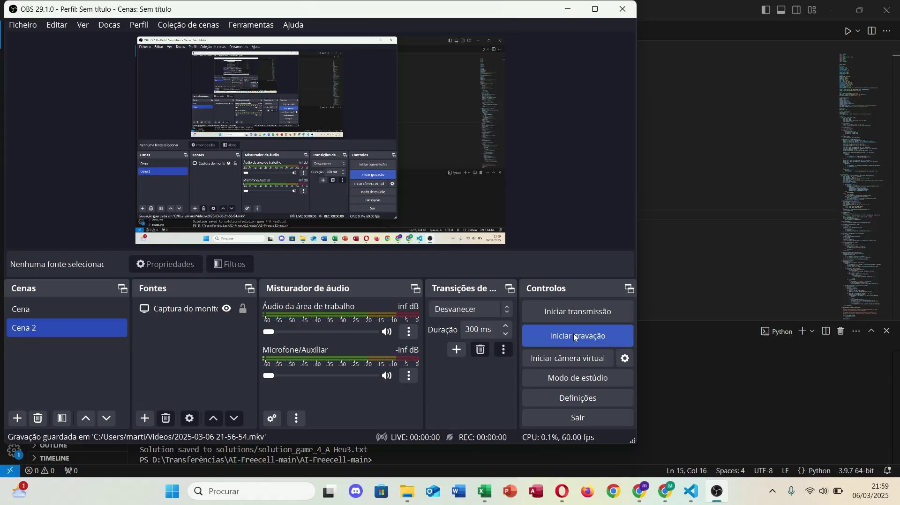
Demo
Notes:
A* heurística 1 - funcionou com 12 cartas e deu a melhor solução mas ficou por aí e não consegui resolver com 28 e 52 cartas. Gastou um bocado de memória e tempo. Chegou a um depth de 14/16 para um maior número de cartasA* heurística 2 - De uma forma geral o melhor algoritmo para jogos aleatórios. Quando comparado com os outros algoritmos deu a melhor solução num tempo bastante rápido e gastando pouca memória. Algoritmo nº 1A* heurística 3 - Segundo melhor algoritmo com segundos melhores resultados. A solução ótima é pior que o A* com heurística 2 contudo a memória utilizada e tempo são semelhantesWeighted A* - Resultados subótimos com bastante tempo gasto na solução para 52 cartas sem automoves (17 segundos quando por exemplo para o A* heurística 2 foram 1,4 segundos). Custa pouca memóriaGreedy - Igualmente resultados subótimos piores que o Weighted A* com bastante tempo necessário para 52 cartas e soluções ótimas mais do dobro quando comparadas com o A* heurística 2 para 52 cartas

Slide 15
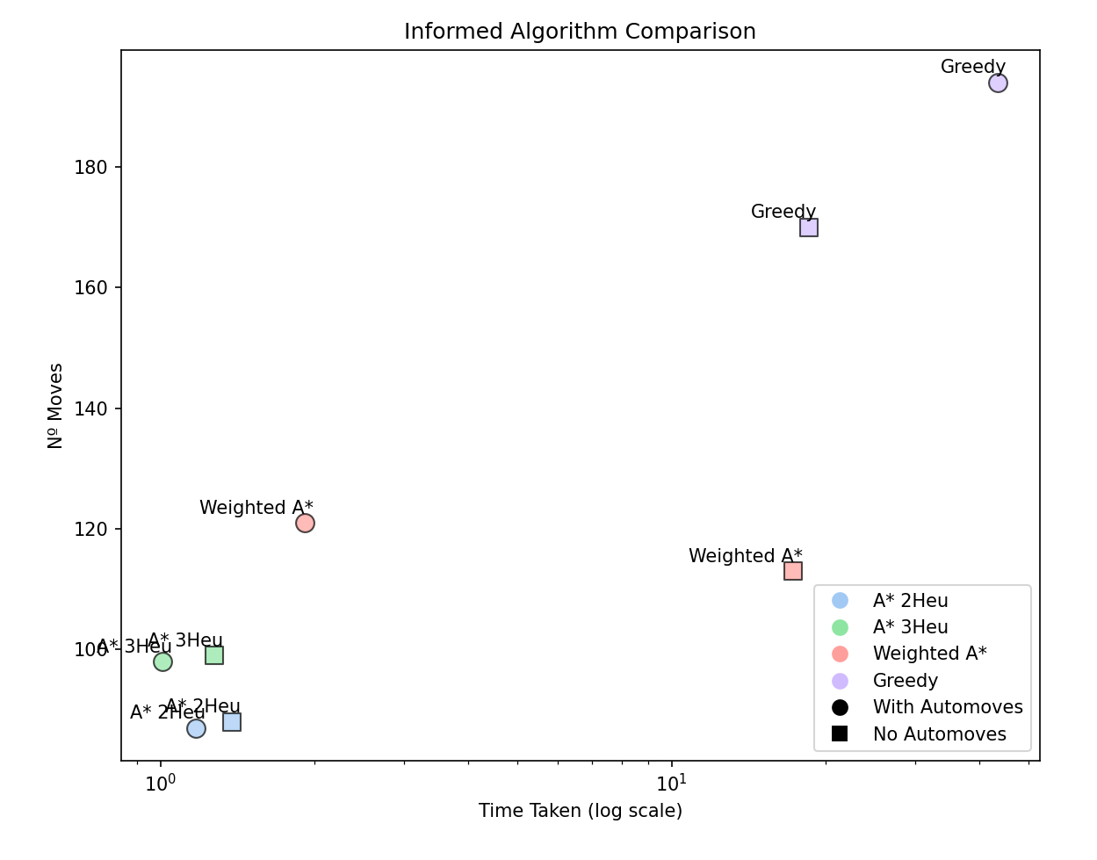
Informed Algorithms Comparison
200 000 Max States
Apart from heurist 1, every heuristic found a solution for 52 cards deals.
A* with the second Heuristic was the best overall method, regarding best solution .
Greedy was the worst algorithm
*Weighted A* and Greedy algorithms were tested using the Heuristic 3
Notes:
A* heurística 1 - funcionou com 12 cartas e deu a melhor solução mas ficou por aí e não consegui resolver com 28 e 52 cartas. Gastou um bocado de memória e tempo. Chegou a um depth de 14/16 para um maior número de cartasA* heurística 2 - De uma forma geral o melhor algoritmo para jogos aleatórios. Quando comparado com os outros algoritmos deu a melhor solução num tempo bastante rápido e gastando pouca memória. Algoritmo nº 1A* heurística 3 - Segundo melhor algoritmo com segundos melhores resultados. A solução ótima é pior que o A* com heurística 2 contudo a memória utilizada e tempo são semelhantesWeighted A* - Resultados subótimos com bastante tempo gasto na solução para 52 cartas sem automoves (17 segundos quando por exemplo para o A* heurística 2 foram 1,4 segundos). Custa pouca memóriaGreedy - Igualmente resultados subótimos piores que o Weighted A* com bastante tempo necessário para 52 cartas e soluções ótimas mais do dobro quando comparadas com o A* heurística 2 para 52 cartas

Slide 16
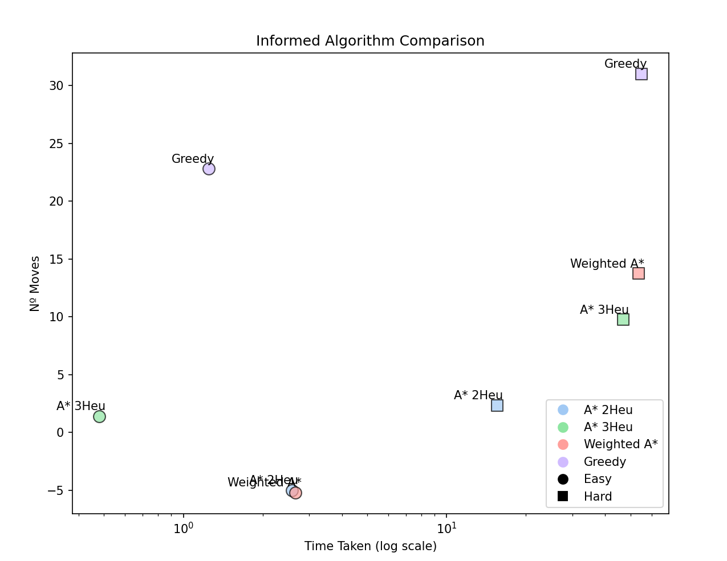
Informed Algorithms Comparison
500 000 Max States
For easy problems A* with heuristic 2 weighted A* were the best algorithms
For hard problems, altough A* with heurist 2 got the solutions with best moves, it was not able to solve every setup predefined.
Different heuristics have different use cases
Notes:
A* heurística 1 - funcionou com 12 cartas e deu a melhor solução mas ficou por aí e não consegui resolver com 28 e 52 cartas. Gastou um bocado de memória e tempo. Chegou a um depth de 14/16 para um maior número de cartasA* heurística 2 - De uma forma geral o melhor algoritmo para jogos aleatórios. Quando comparado com os outros algoritmos deu a melhor solução num tempo bastante rápido e gastando pouca memória. Algoritmo nº 1A* heurística 3 - Segundo melhor algoritmo com segundos melhores resultados. A solução ótima é pior que o A* com heurística 2 contudo a memória utilizada e tempo são semelhantesWeighted A* - Resultados subótimos com bastante tempo gasto na solução para 52 cartas sem automoves (17 segundos quando por exemplo para o A* heurística 2 foram 1,4 segundos). Custa pouca memóriaGreedy - Igualmente resultados subótimos piores que o Weighted A* com bastante tempo necessário para 52 cartas e soluções ótimas mais do dobro quando comparadas com o A* heurística 2 para 52 cartas

Slide 17

Meta Heuristic
Evaluates the game state like a Human would.
Scores based on strategys
More cards in foundation the better
Penalizes usage of freecells
Penalizes cascades without sequences
Penalizes lack of card mobility
Applies A*. The lower the score the better
Results
Did not reveal to be a good model
The solutions were not optimal and cost a lot of memory
Found only 1 solution for the hard problems
.

Slide 18

Meta Heuristic 2
The second meta heuristic resembled the first one in many aspects altough simpler and with changed score values.
These were the criteria:
A rewards for each card in the foundations, with a reward of 10 points per card.
A penalizes free cells occupied by a card, with 5 points for each card.
A penalizes for each pair of consecutive cards in the cascades that are not in the correct sequence (i.e., rank and color mismatched).
Although the changes were not that significant, it led to huge increases in performance regarding better solutions and less time taken, revealing once more the impact that heuristics have in the performance of informed solvers
Results
For easy games, both the solutions and time spent were better than A* with heuristic 3.
For hard games, was able to solve one more problem than the other Meta Heuristic
.

Slide 19
04
Single Player

Slide 20
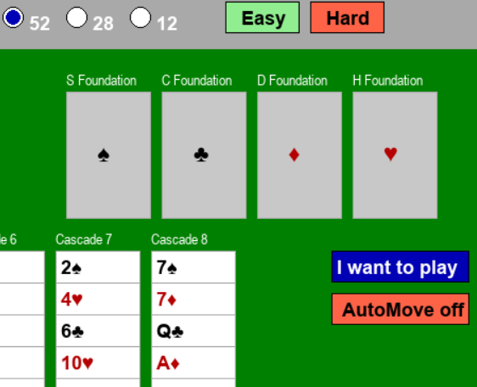
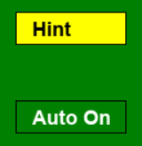
Single player
When you load a new game, you can also play it yourself by clicking "I want to play !"
If you are not sure about which move you should do next you can ask for a "Hint" that will be calculated using the current state and the algorithm that is selected in the Algorithm Box. It is important to choose an algorithm that is able to solve games with those characteristics (for example it would be most efficient to not use "Depth First Search" if the game has 28 or 52 cards). This information can be seen in a table in the last slides.
Besides that you can also activate "Automatic Moves" and "Undo" your latest move.
"Auto On" visible Click if you want to activate Automoves
"Auto Off" visible Click if you want to deactivate Automoves

Slide 21
05
LLMs

Slide 22
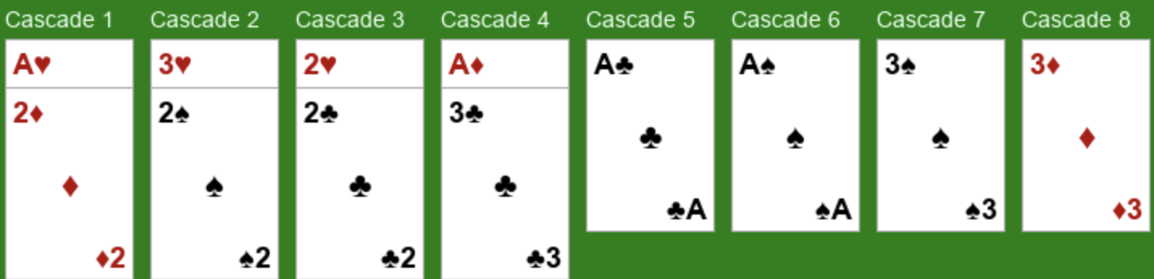
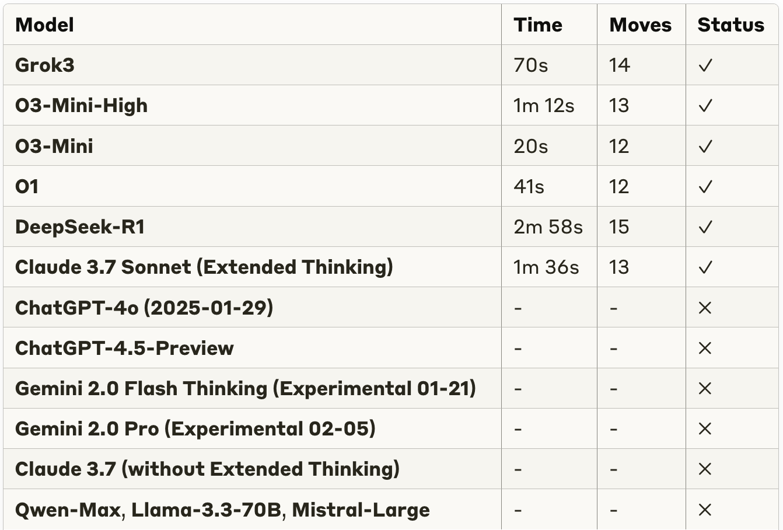
Experience with LLMs
Zero shot attempt with FreeCell solitaire puzzle with 12 cards
Only reasoning models successfully solved the puzzle (6/14 models)
O3-Mini (smaller model) found most efficient solution (12 moves) in shortest time (20s)
LLMs are not reliable today for these tests (they struggle with more cards/complexity and cost more than traditional algorithms).
Prompt follows the good practices (goal, input format, return format, context)
Zero shot attempt

Slide 23
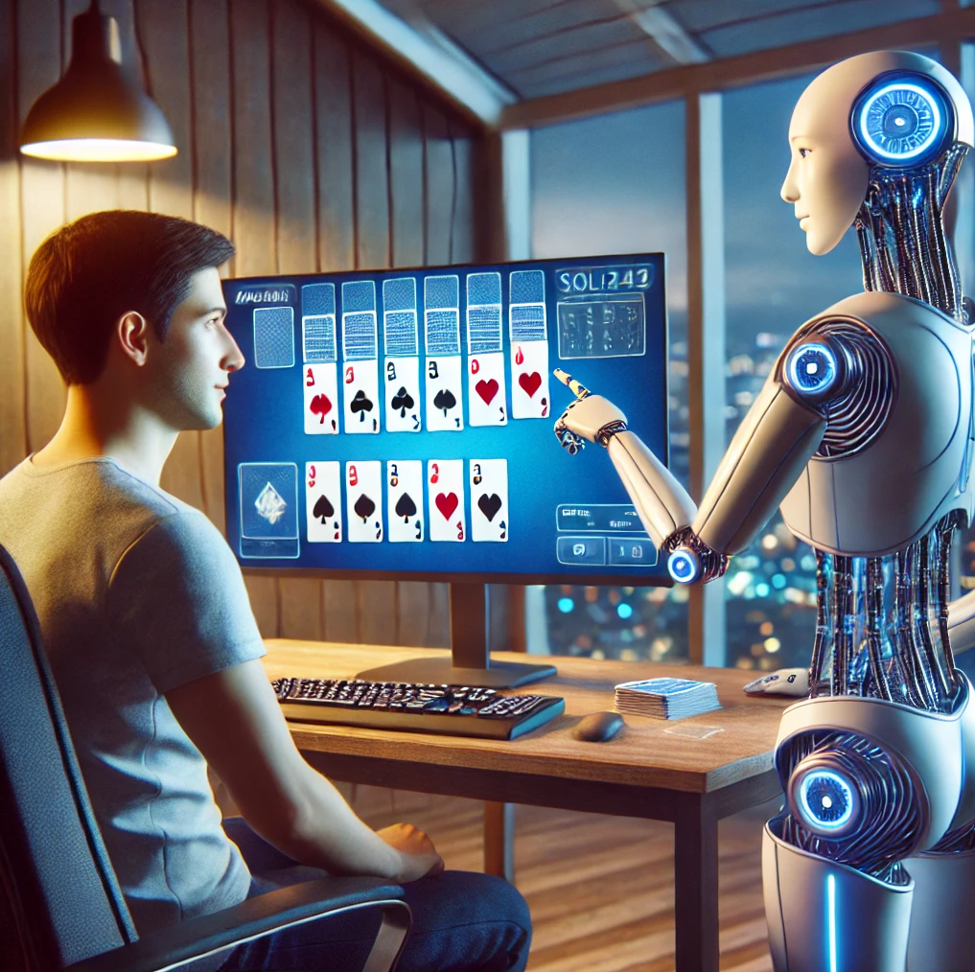
Designing a Freecell LLM Agent
A customized prompt for the LLM to be friendly, funny, and educational if necessary.
The LLM will have access to various functions that it can call to have full knowledge of the board’s state and make informed and legal choices.
Function-Based Game Understanding
Getting valid moves and board state (Get_Valid_Move(), Make_move())
Executing moves and suggesting hints (Get_Hints())
Finding complete solution paths (Solve_Game())
Supporting voice interaction

Slide 24


Looking Back and Ahead
Uniformed search methods can be very limiting
The Heuristic choice has a great impact in both the solution and capabilities of the algorithm
Test with more powerfull computers, more states and depth
Look into aplying these algorithms to other solitaire types
Possibly transforming this game into an optimization problem

Slide 25
THANKS!
Do you have any questions?
João Soares up202105364
João Vieira up202107689
Martim Lousado up202104630

Slide 26
06
Results

Slide 27
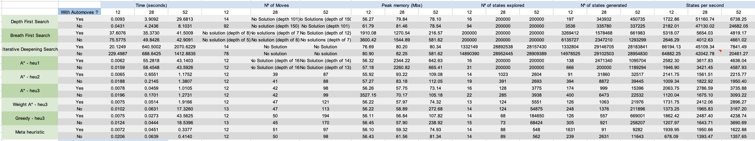
Results regarding number of cards
12 cards | game2.txt
28 cards | game3.txt
52 cards | game4.txt

Slide 28
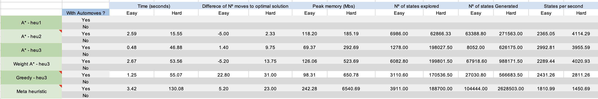
Results regarding difficulty setting

Slide 29
Results for Meta Heurist 2

Slide 30
Results for removing E2E moves

Slide 31
References
Artificial Intelligence: A Modern Approach code repository. (2019, July 20). GitHub. https://github.com/aimacode
Artificial Intelligence: A Modern Approach, 4th US ed. (n.d.). Aima.cs.berkeley.edu. https://aima.cs.berkeley.edu
Easy and difficult games | FreeCell Solutions. (2025). Freecellgamesolutions.com. https://freecellgamesolutions.com/stats.html
View of Optimal Solitaire Game Solutions Using A* Search and Deadlock Analysis. (2025). Aaai.org. https://ojs.aaai.org/index.php/SOCS/article/view/18405/18196
Wikipedia Contributors. (2024, November 28). FreeCell. Wikipedia; Wikimedia Foundation. https://en.wikipedia.org/wiki/FreeCell
Yan, X., Diaconis, P., Rusmevichientong, P., & Roy, B. (n.d.). Solitaire: Man Versus Machine. https://web.stanford.edu/~bvr/pubs/solitaire.pdf
Notes:
Talk about what was done and maybe a video

